Slide 1
Oracle Enterprise Resource Planning(ERP)
Group 2 Purchasing Project

Slide 2
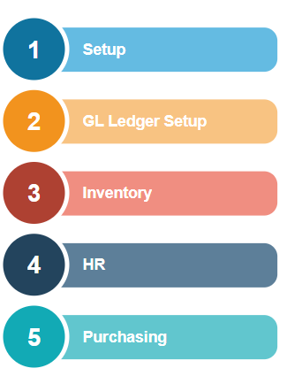
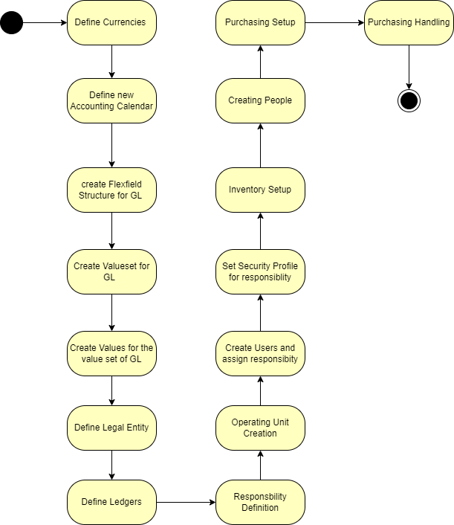
Introduction

Slide 3
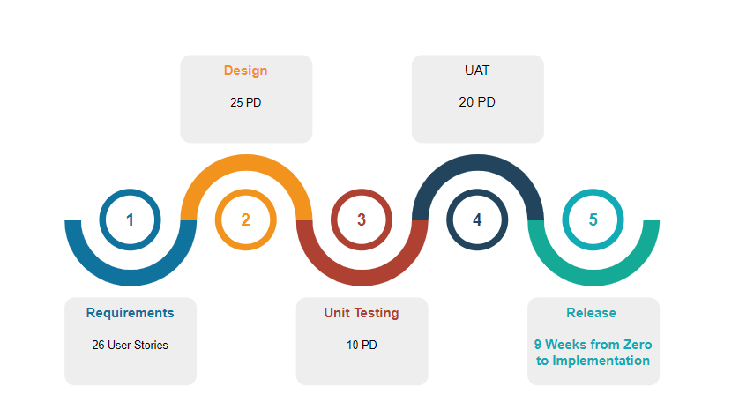
Project Phases

Slide 4
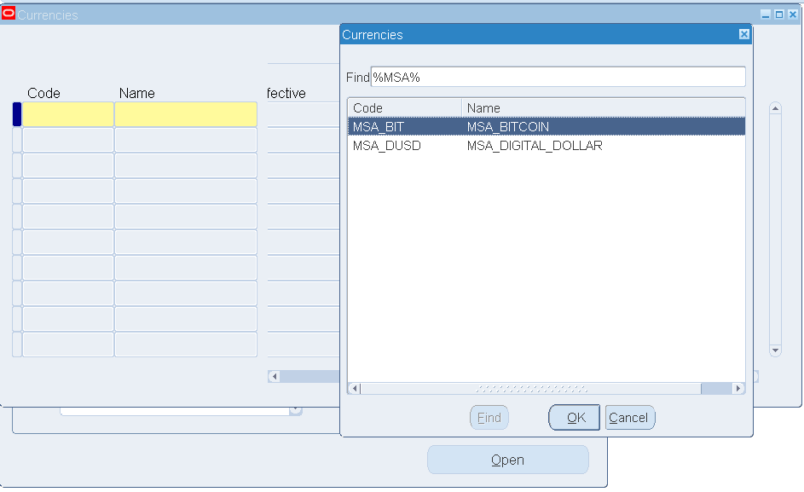
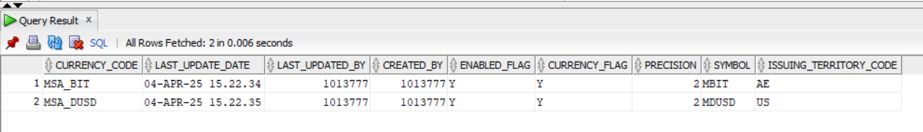
Define New Currencies
This project will utilize two currencies
  Digital USD (MSA_DUSD)
  Bitcoin (MSA_BIT)
  Both currencies were defined in the Virtual machine but we have redefined both of them.
  Required Responsibity: General Ledger super user
  Path : setup > currencies > define

Slide 5
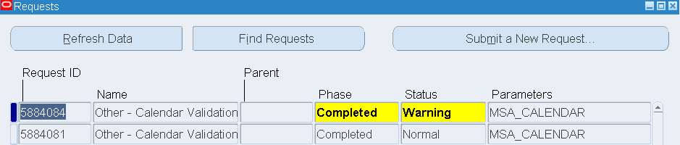
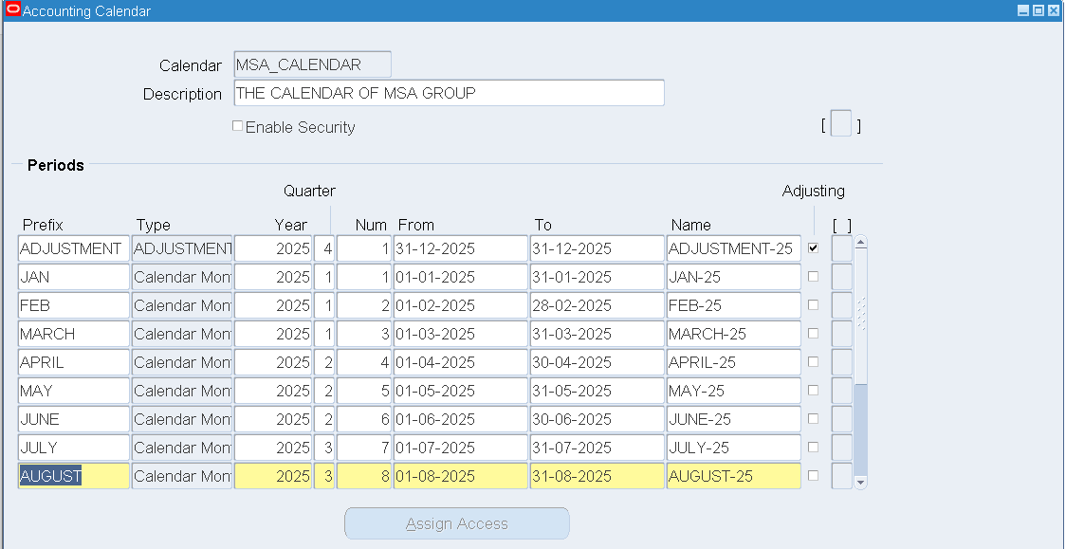
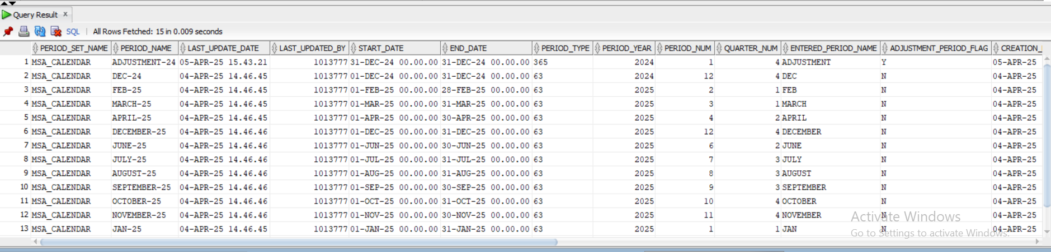
Define New Calendar
Required Responsibility: General Ledger
Path: setup>Financials>calendars> Accounting

Slide 6
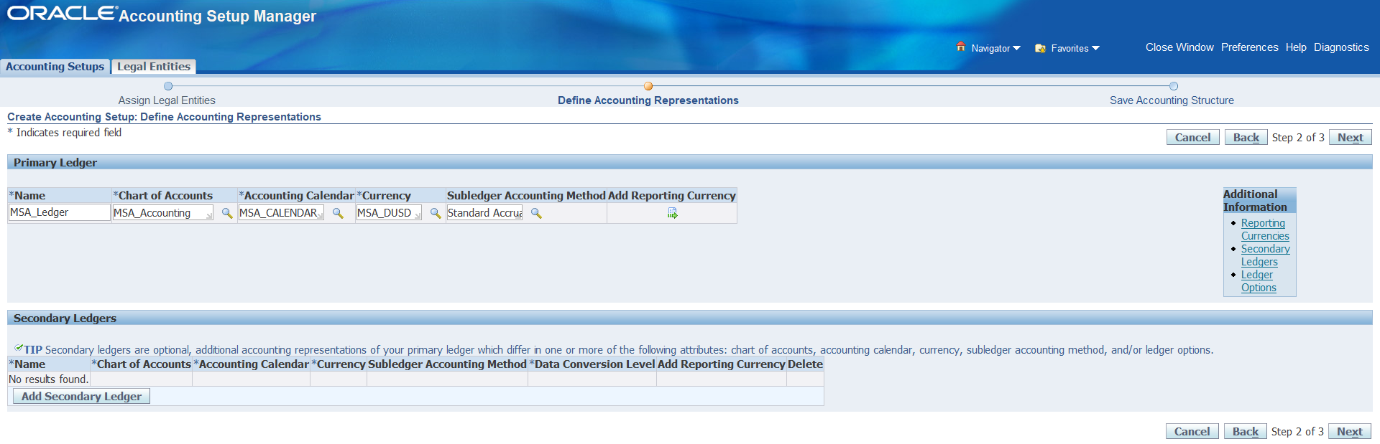
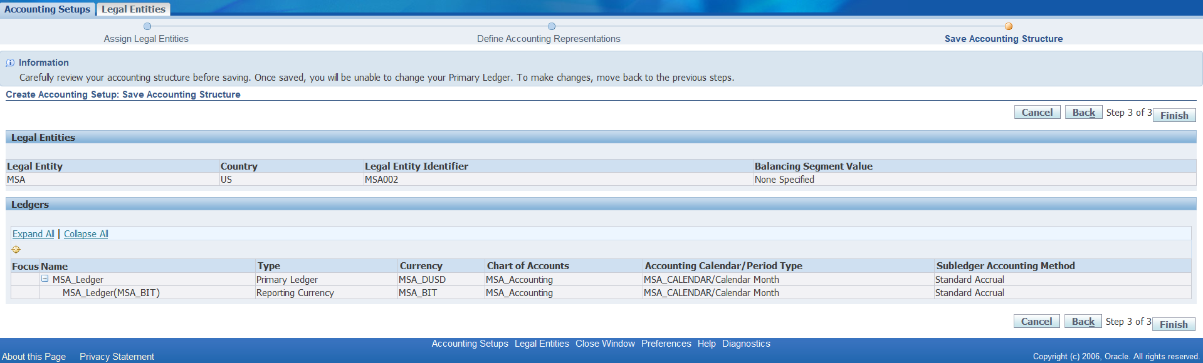
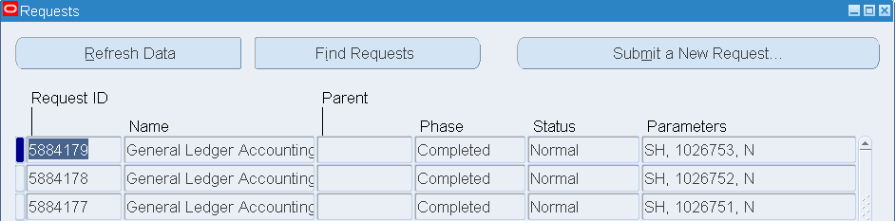
Define Ledger Handling
Required Responsibility: Global Ledger super user> setup > financials>accounting setup Manager> accounting Setups
Select accounting setup
  Choose the defined legal entity (MSA).
  Add the defined calendar , currency(MSA_USD) , reporting currency(MSA_BIT).

Slide 7
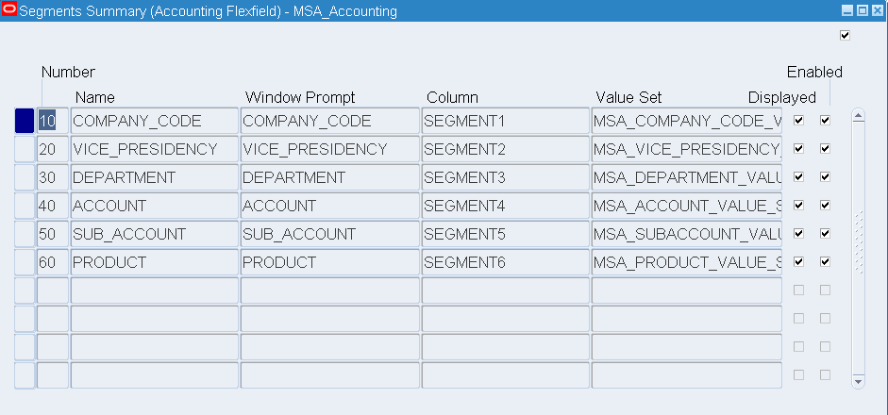
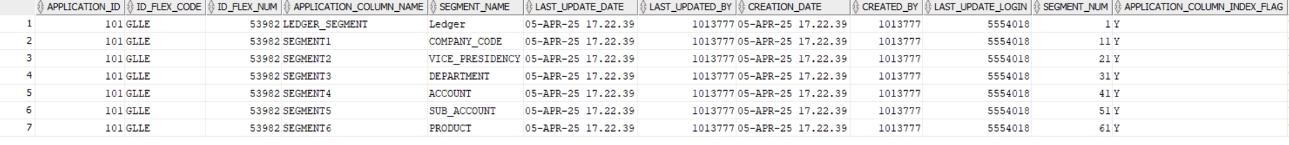
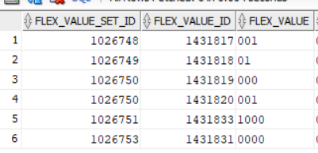
Accounting Flex fields Segments and values

Slide 8
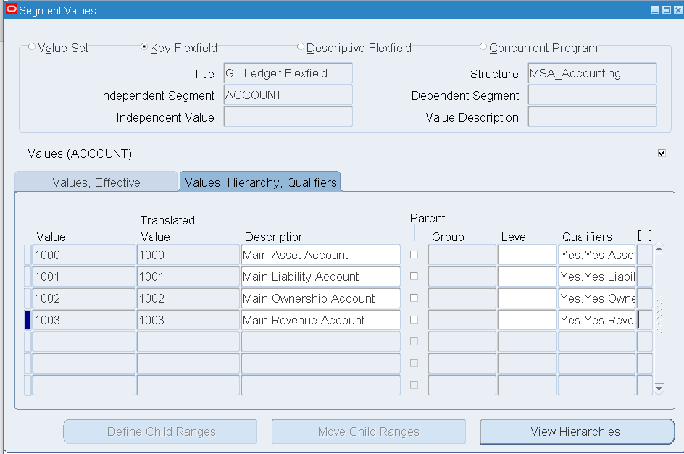
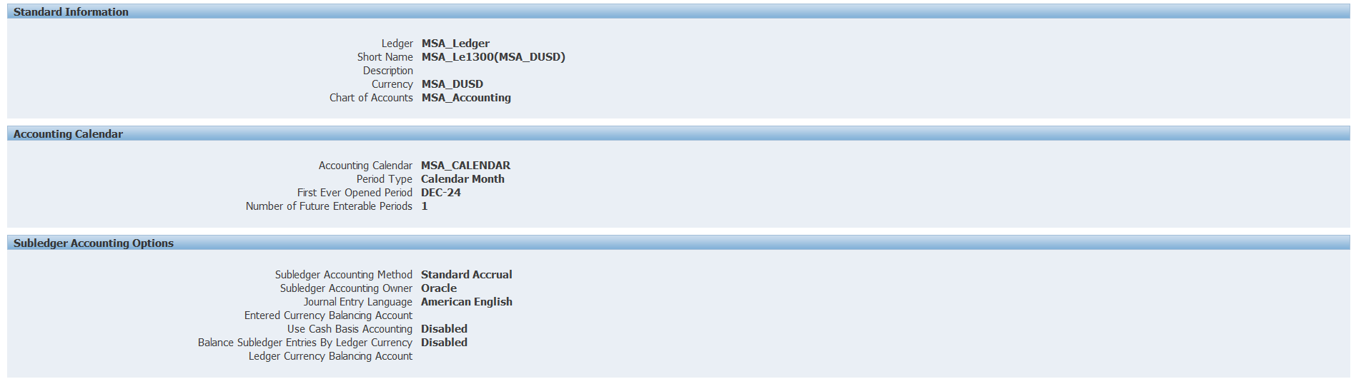
Accounting FlexField segments & Values 2

Slide 9
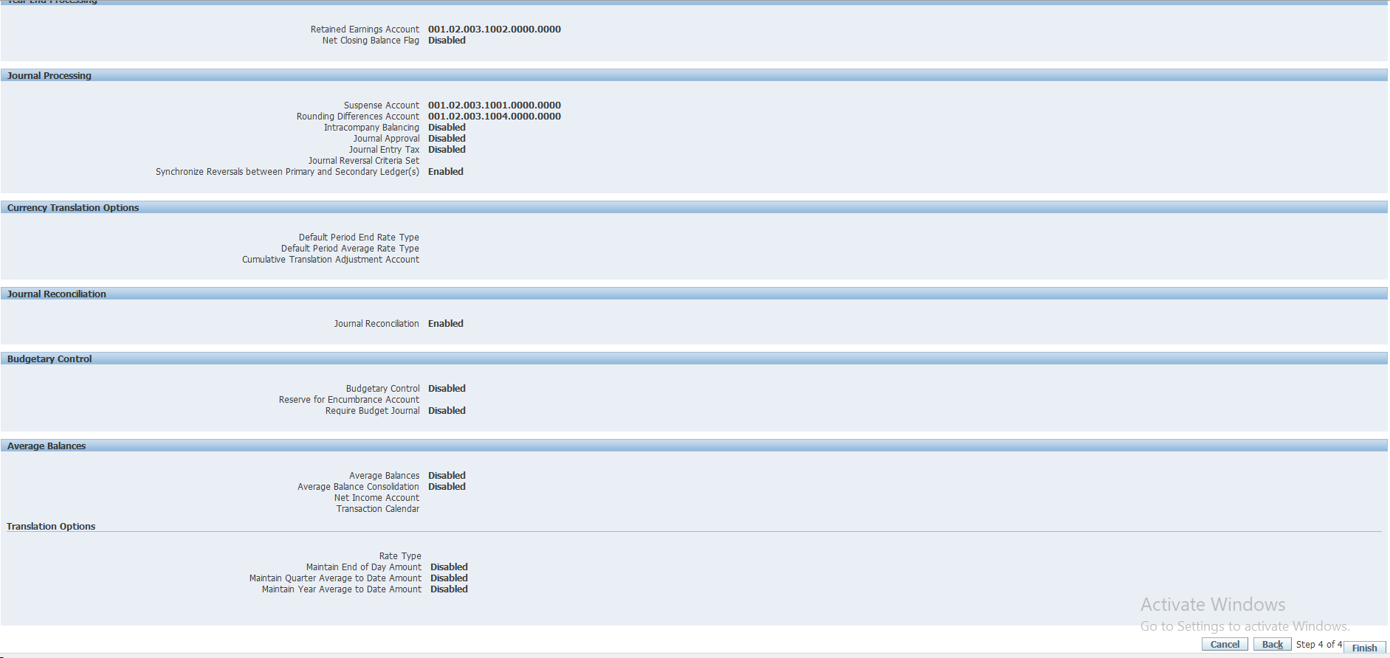
General Ledger Setup Verfication

Slide 10
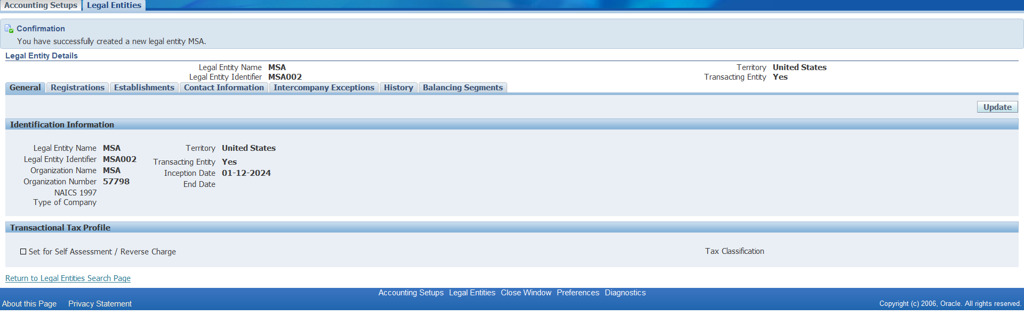
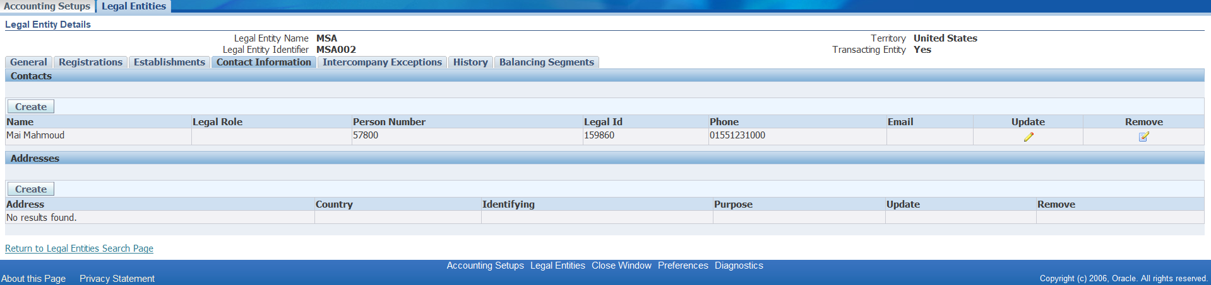
Define Legal Entity
Required Responsibility: Global Ledger super user> setup > financials>accounting setup Manager> accounting Setups
Provide the required information then save.

Slide 11
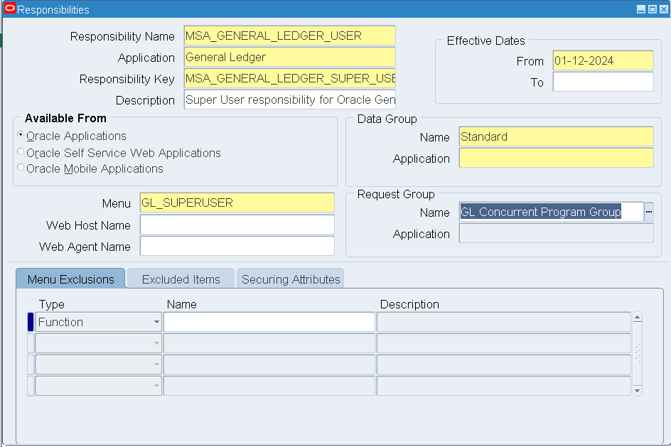
LEDGER RESPONSIBILITY DEFINITION

Slide 12
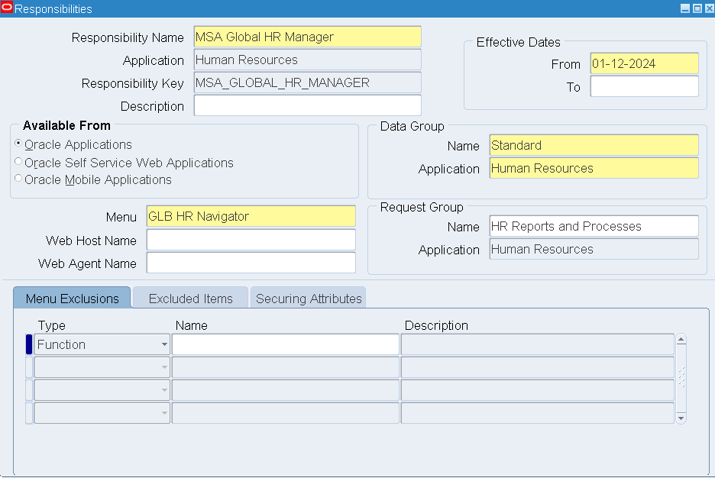
HR Responsibility

Slide 13
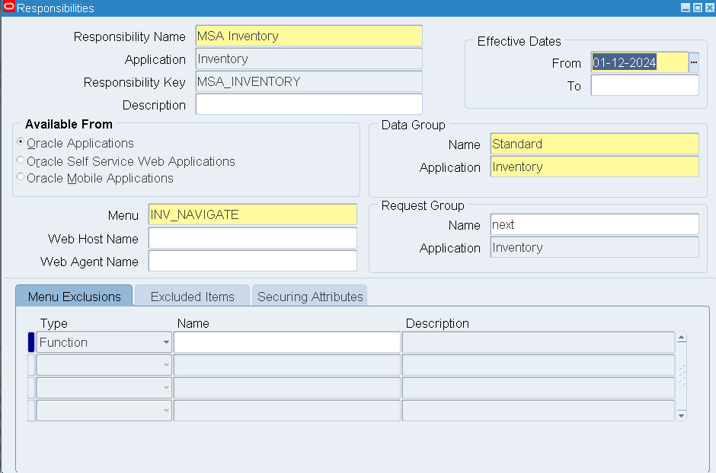
INVENTORY RESPONSIBILTY

Slide 14
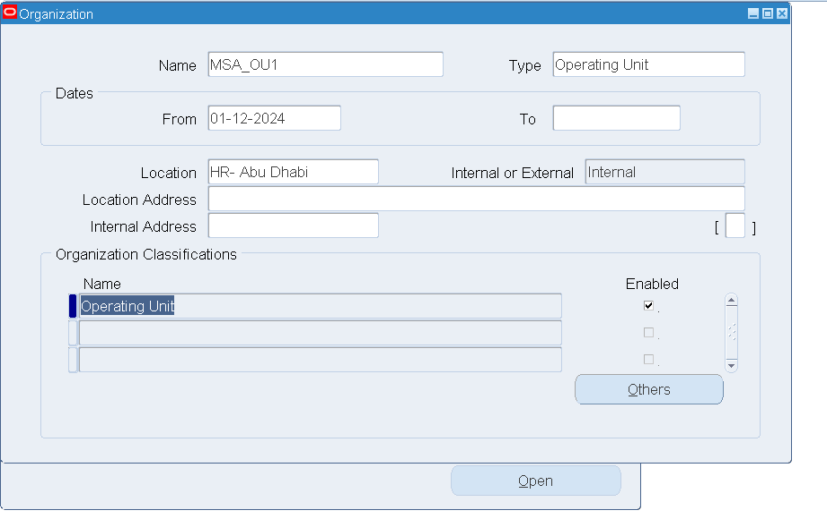
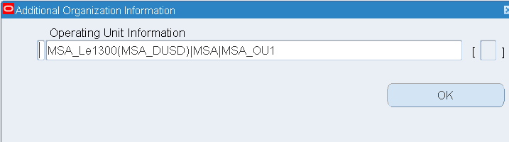
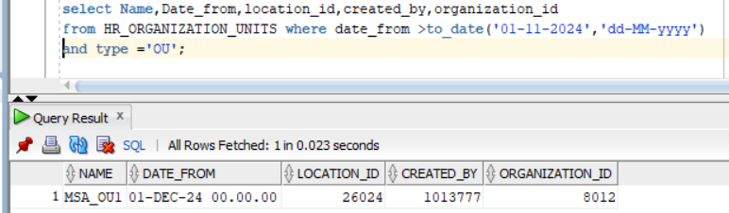
Creating an operating unit

Slide 15
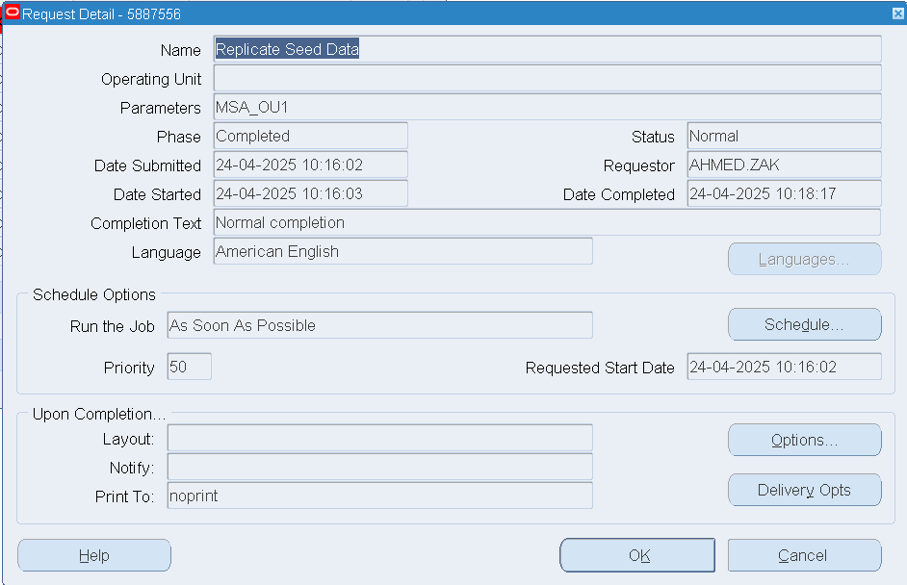
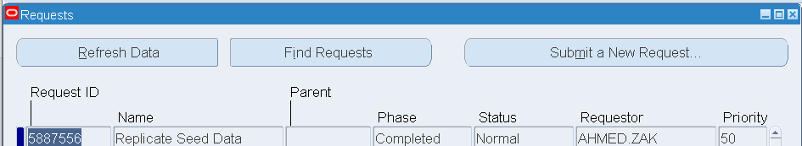
Create Operating Unit 2

Slide 16
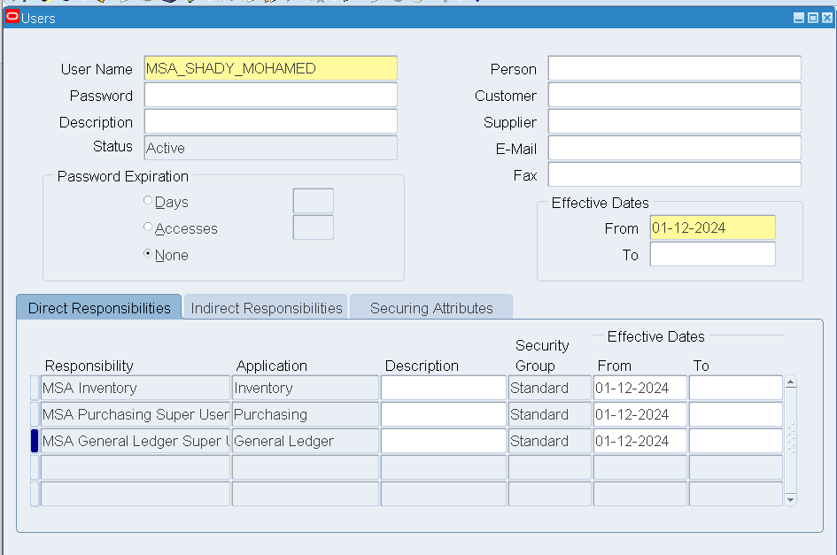
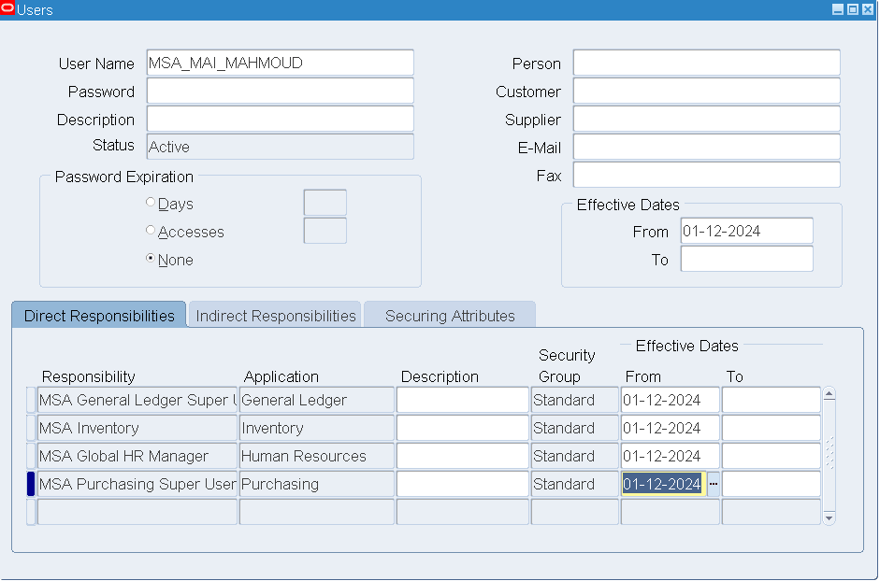
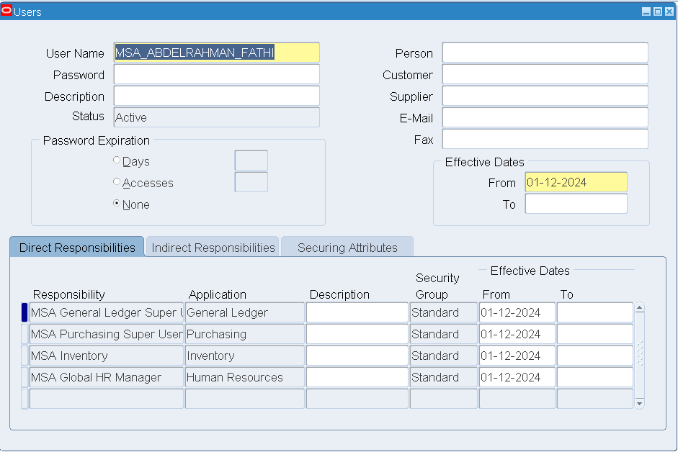
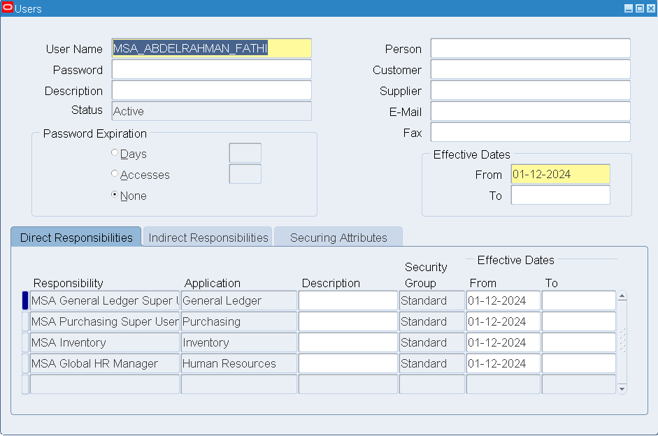
Users Creation

Slide 17
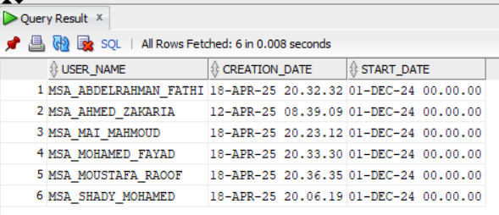
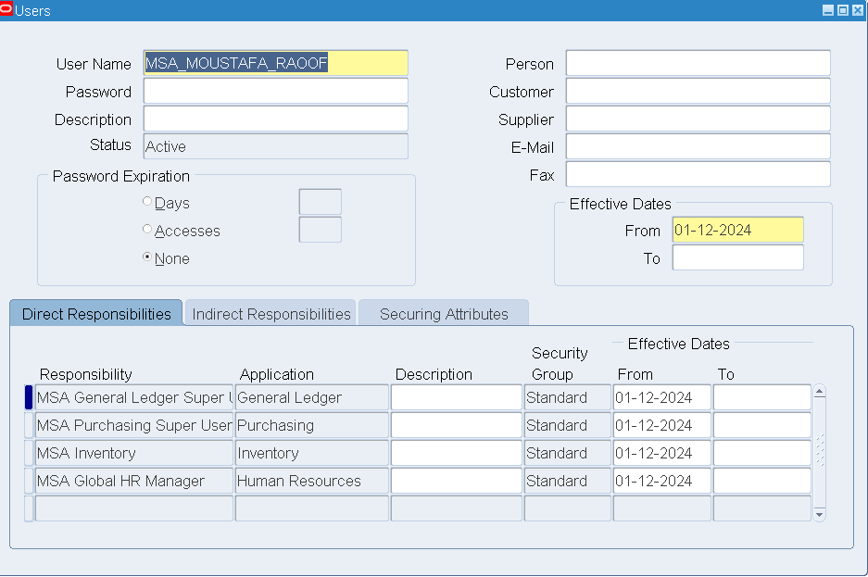
User Creation 2

Slide 18
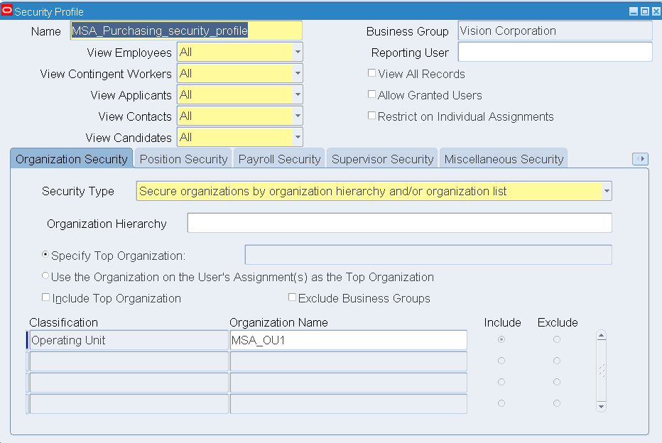
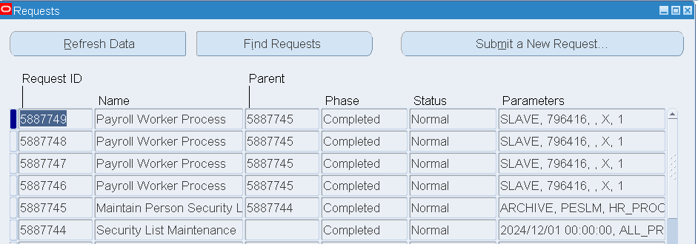
Setup security profile for responsbilities
The request “Maintain person security list”

Slide 19
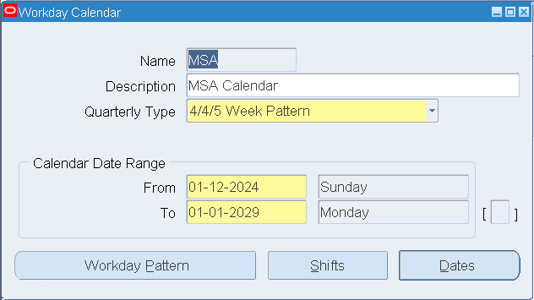
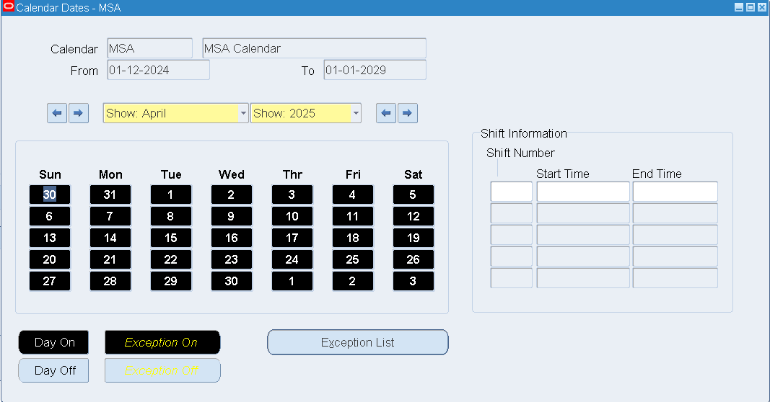
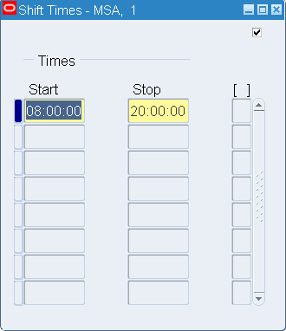
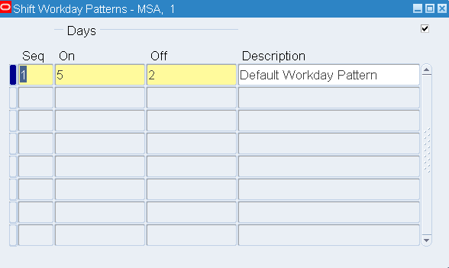
Define Workday calendar 1

Slide 20
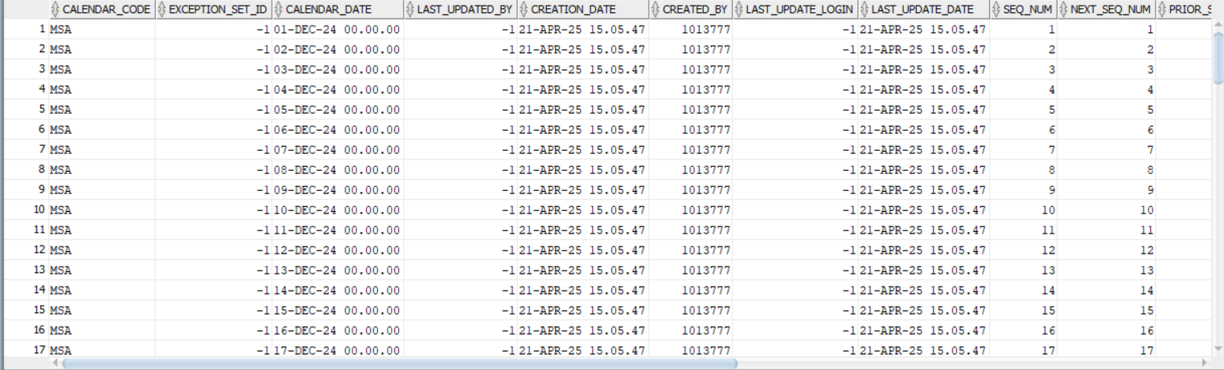
Define Workday Calendar 2
Tools>build

Slide 21
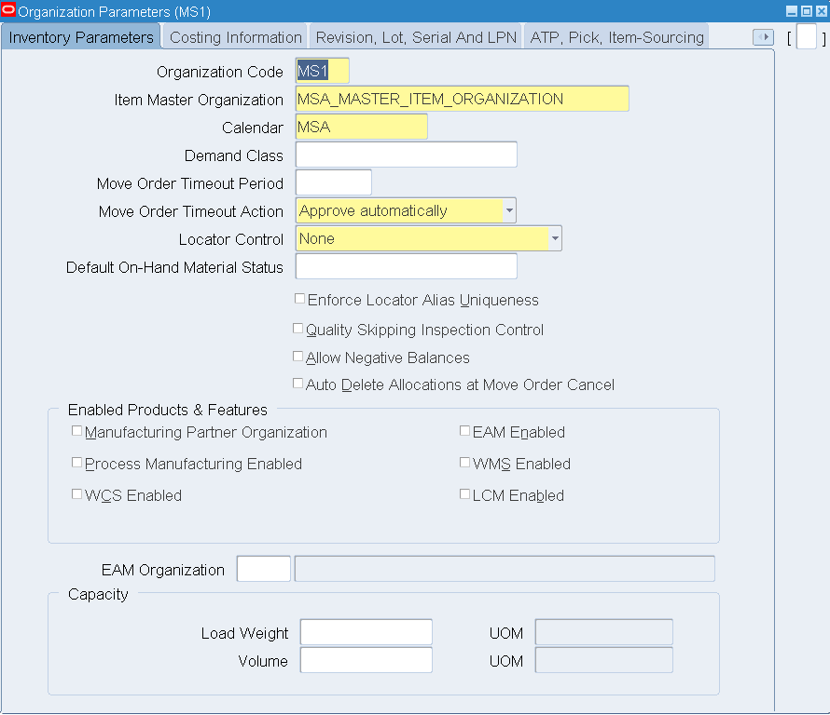
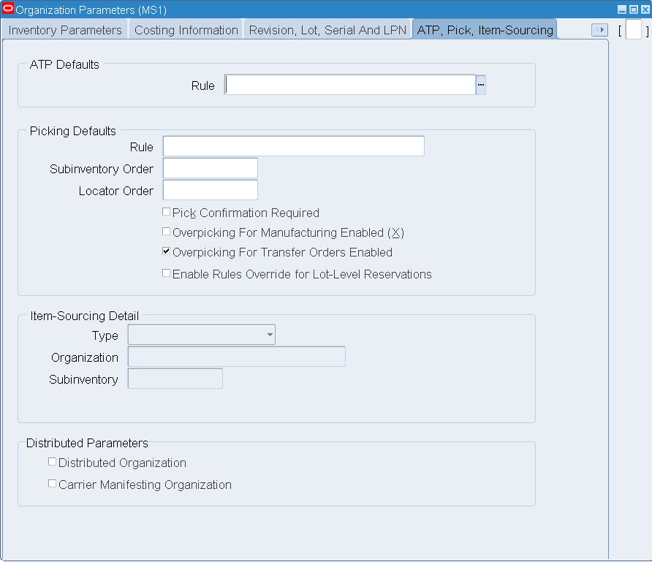
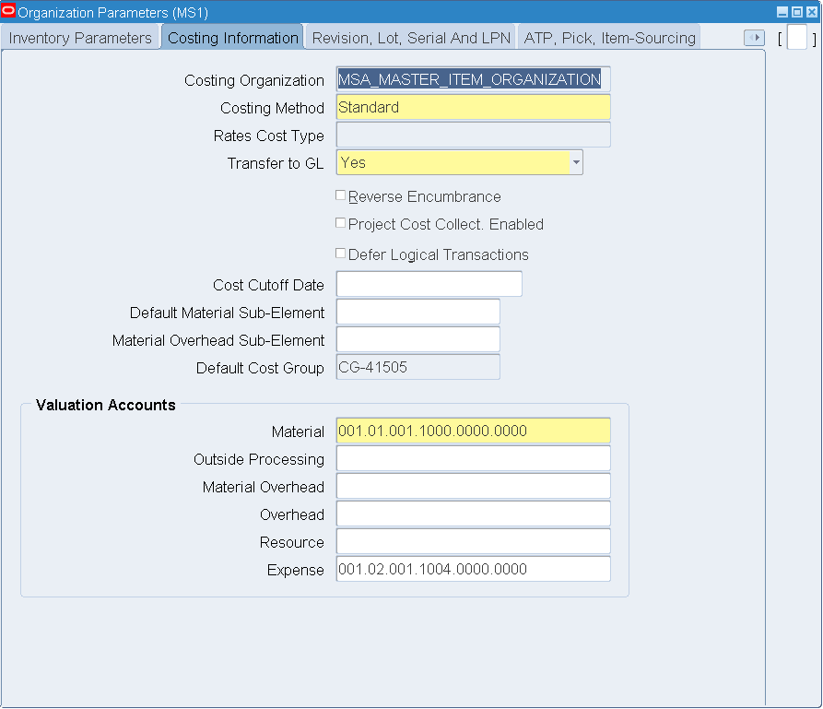
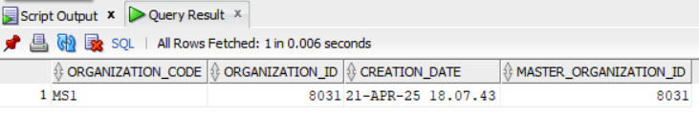
MASTER ITEM Organization Definition

Slide 22
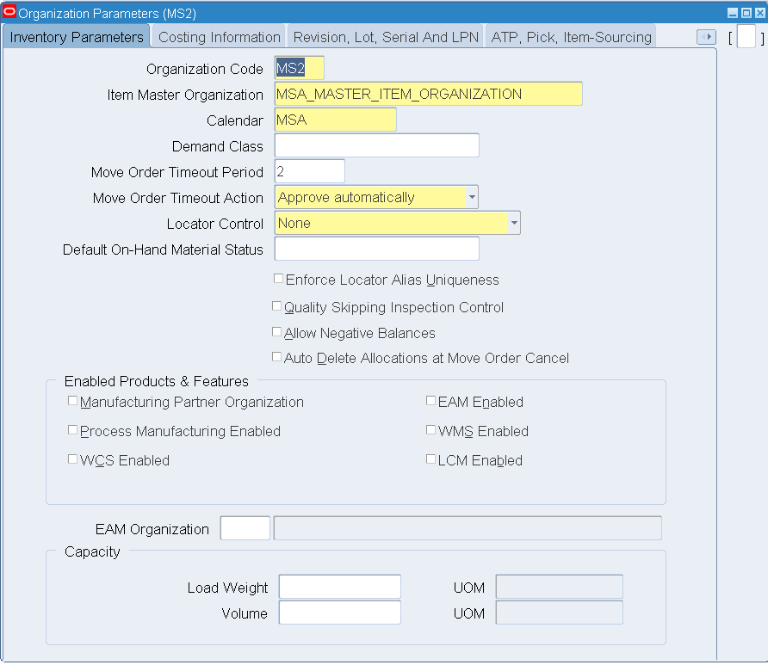
MSA Inventory Organization Definition

Slide 23
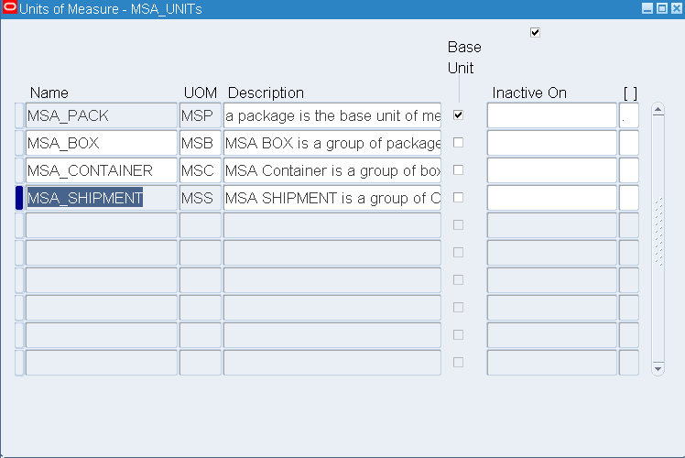
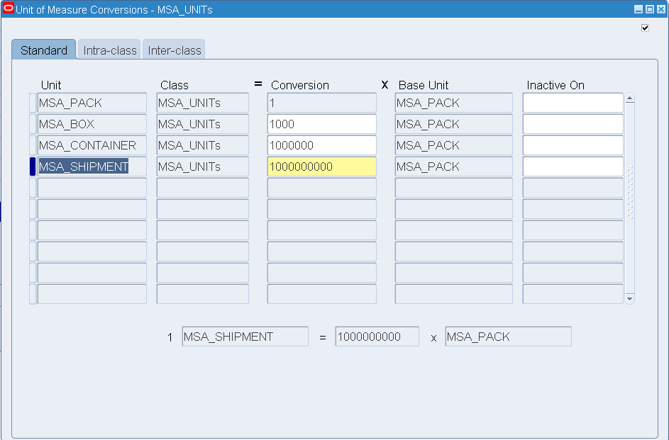
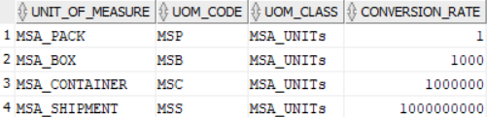
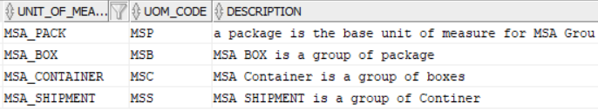
Unit of Measure Classes and Conversions

Slide 24
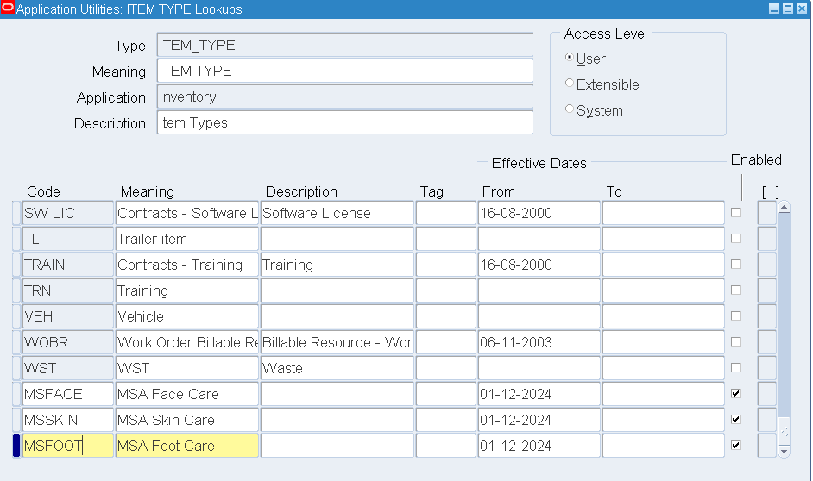
Item Type Definition

Slide 25
Item Templates

Slide 26


Item Definition

Slide 27




Create People in the system

Slide 28

Purchasing Module (Financial Options)

Slide 29


Purchasing Options1

Slide 30

Purchasing Options 2

Slide 31




Create Supplier & Supplier Sites

Slide 32


Supplier Definition 2
Purchasing > Supply Base > suppliers

Slide 33



ITEM Category Configuration

Slide 34

Assign Categories to Items

Slide 35
Request for Quotations
Request for Quotations : a purchasing document sent to supplier to inquiry about prices and terms of items.
Catalog RFQ
  High Volume
  Price breaks
BID RFQ
  High Volume
  One time purchase
  No price breaks
Standard RFQ
  Price breaks
  More flexible

Slide 36



Request For Quotation

Slide 37
Thank You

